Slide 1
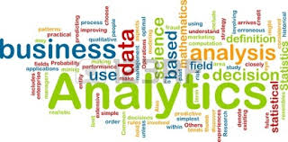
Business Analytics Concepts

Slide 2
Videos : BUSINESS ANALYTICS
Video:
Turning Data into Insights
http://youtu.be/6jDjeNJrN14
Video:
Data Trends let businesses spot
opportunities
http://youtu.be/HbHTvqZE3D8

Slide 3
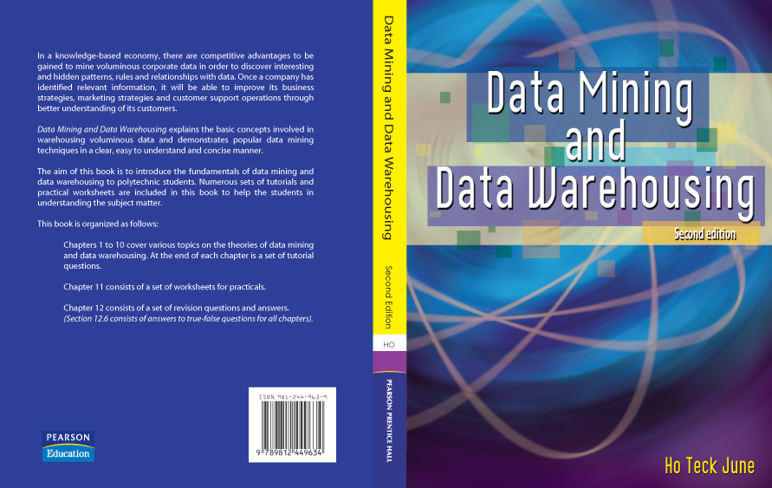
Reference Text Book:

Slide 4
Topic 1: Business Analytics Concepts (chapter 1 of DM and Data Warehousing textbook)
What is Business Analytics?
Importance of Business Analytics
Business Analytics Maturity Curve
Data for Analytics
Supervised and unsupervised learning
Data mining Tasks
Analytics Applications
Business Analytics Methodologies

Slide 5
What is Business Analytics?
Business Analytics is the use of data, information technology, statistical analysis, quantitative methods and computer-based models to help managers to gain insights about their business operations so that they could make better fact-based decision.
Other names: data mining, knowledge extraction, pattern analysis, knowledge discovery, information harvesting, pattern searching & data dredging

Slide 6
The Traditional Decision-making Process
Decision
Information
Experience
External
Internal
Business
data
data
rules

Slide 7
An Analytics-based Decision-making Process
Decision
Information
Experience
Intelligence
Data
External
Internal
Business
Mining
data
data
rules
Analytics
Systematic
analysis
Empirical
rules

Slide 8
Importance of Business Analytics
There is a strong relationship of BA with:
- profitability of businesses
- revenue of businesses
- shareholder return
BA enhances understanding of data
BA is vital for businesses to remain competitive
BA enables creation of informative reports

Slide 9
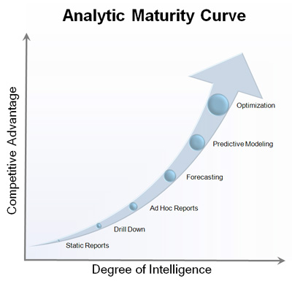
Regression analysis
Discrete choice modeling
Mathematical optimization
Simulation and scenario development
Clustering and segmentation
Trend Analysis and Forecasting
Data visualization
Standardized reporting
Prescriptive
Predictive
Descriptive
Tom Davenport: Competing on Analytics
Notes:
What is descriptive analytics?
Discovering new patterns inside the data
Used during the data exploration steps
Typical questions answered by descriptive analytics
what is in the data
what does it look like
Are there any unusual patterns
what dose the data suggest for customer segmentation
Data mining tasks include association analysis and cluster analysis
What is predictive analytics?
Using known examples the model is trained. The unknown function is learned from data.
The more data with known outcomes is available, the better the predictive power of the model
Used to predict outcomes whose inputs are known but the output values are not realized yet
Typical questions answered by predictive analytics
Who is likely to respond to our next offer
based on history of previous marketing campaigns
Which customers are likely to leave in the next six months
What transactions are likely to be fraudulent
based on known examples of fraud
What is the total amount spending of a customer in the next month
Data Mining tasks include decision tree technique and neural network technique
Explanation
Reports such as standard reports, drill down reports and ad hoc reports are generated. They are then analysed to uncover insights from historical data. Statistical analysis, forecasting, predictive modeling and optimization are the core of business analytics. It aims to uncover insights from historical data and generate projections into the future, using analytical processes in alignment with business requirements.
Descriptive Analytics
Reports
Standard reports
It focuses on understanding what has happened. For example, reviewing a company’s annual report and pinpointing various events.
Questions that a report can answer include “What was sold?”
Drill Down Reports
It is an online analytical processing (OLAP) diving deeper into the event, answering questions such as “Where did the
event happen? Where exactly was the problem?”
Ad Hoc Reports
After gaining knowledge of events through the standard reports, secondary questions such as “When did it happen?
How many times did it occur during a particular period of time?” Reports are then generated to answer the particular
questions of interest.
Statistical Analysis
The data are analysed using statistical models in an attempt to understand why the event occurred. Question such as “What are the most significant factors associated with complaints?”
Forecasting
This is to focus on deriving insights. One of the key elements of business analytics is the capability of prospective quantitative forecasting. Using historical data, forecasting methods identify past patterns and trends in the data and use those to create future forecasts of overall behaviour. It will help to answer questions such as “What will quarterly sales look like next year?”
Predictive Analytics
Predictive Modeling
It generates future predictions for individual records. Unlike forecasting, prediction deals with individual events rather than overall trends. Predictive modeling looks at measurements of many records at a single point in time, and uses those to generate predictions for new records. Question such as “Which complaints from which customer segments are most likely to escalate?”
Prescriptive Analytics
Optimization
It combines the generated intelligence to optimize business processes or objectives, given operational and other constraints. This level, utilizing insights, forecasts and predictions from previous levels. It answers questions such as “ How to maximize profit subject to infrastructure constraints? How to optimally allocate resources subject to a set of priorities?”

Slide 10
Application of Analytics in Retail Sector
Example 1: Retail Markdown Decisions
Most department stores clear seasonal inventory by reducing prices.
The question is:
When to reduce the price and by how much?
Descriptive analytics: examine historical data for similar products (prices, units sold, advertising, …)
Predictive analytics: predict sales based on price
Prescriptive analytics: find the best sets of pricing and advertising to maximize sales revenue

Slide 11
Application of Analytics in Hotel Sector
Example 2: Agoda E-booking of Hotels
Agoda owns numerous hotels
Uses descriptive analytics to:
- forecast demand for rooms
- segment customers by room types
(luxury or economy)
Uses prescriptive models to:
- set room rates
- allocate rooms
- offer perks and rewards to customers

Slide 12
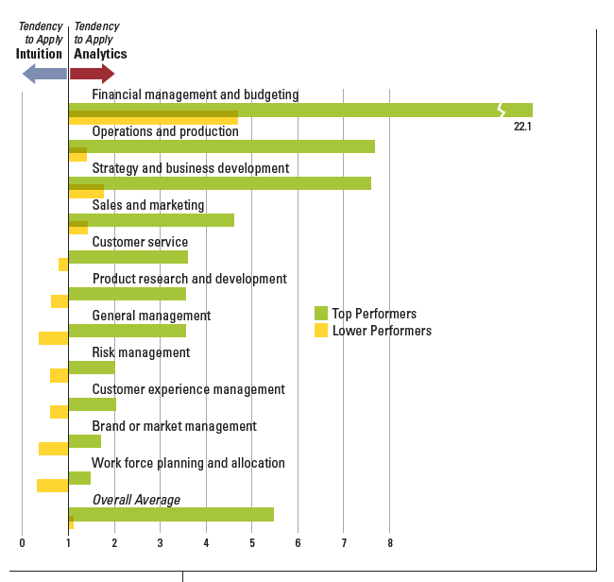
Creating Value from Data Huge Market Potential
Sloan Management Review-IBM surveyed 3000 executives in 2010.
Tendency for high performing organizations (self reported competitive
positioning in industry) to apply analytics to particular activities, as compared to lower performing organizations

Slide 13
Data for Analytics
Data: a collection of facts usually obtained as the result of experiences, observations, or experiments
Data may consist of numbers, words, and images
Data: lowest level of abstraction (from which information and knowledge are derived)

Slide 14
Video: Types of data - Nominal, Ordinal and Interval/Ratio
http://youtu.be/hZxnzfnt5v8
(Duration is 6:20 mins)
Once you have seen the video, please identify the one type of graph for each data type.
Question:
For ordinal data type, do you recommend pie chart?

Slide 15
Analytics through Data Mining
Analytics are the result of analysis and the form of presentation of those results.
Data Mining is learning from data. This learning from data comes in two flavours: supervised learning and unsupervised learning.
Notes:
Analytics are the result of analysis and the form of presentation of those results. Analysis is the method or methods that can be used to analyze data and the process of analyzing it.
Data mining is a specific statistical technique. Data mining allows you to search through enormous quantities of data without having any idea what you are looking for. It identifies correlations simply through brute force analysis and neural network (learning) techniques

Slide 16
Definition of supervised learning
In supervised learning (often also called directed data mining) the variables under investigation can be split into two groups: independent variables and one (or more) dependent/target variables.
The target of the analysis is to specify a relationship between the independent variables and the dependent variable.
To apply directed data mining techniques the values of the dependent variable must be known for a sufficiently large part of the data set.

Slide 17
Example of supervised learning
To identify top 10% students of DBIT students for a certain cohort
Variables:
Name, nric, tel no, birthdate, semester average, next-of-kin name, next-of-kin tel no, class group, Biz Analytics marks, DBMS marks, Java Programming marks
Question:
Identify the target /dependent variable.

Slide 18
Definition of unsupervised learning
In unsupervised learning (often also called undirected data mining), all variables are treated in the same way, there is no distinction between independent and dependent variables.
The target variable is unknown or has only been recorded for very few number of cases.

Slide 19
Data mining tasks
Classification
Prediction
Association Analysis
Cluster Analysis
Learning Method
Supervised (classification & prediction tasks)
Unsupervised (association analysis and cluster analysis tasks)

Slide 20
Classification
It consists of examining the features/attributes of an object and assigns it to a predefined class.
It will group records having similar characteristics to a predefined class.
It deals with discrete outcomes: yes or no or debit card
Example:
Classifying credit applicants as low, medium or high risk.

Slide 21
Classification Problems & Classification Techniques
Classification Problems:
Given characteristics of individuals differentiate them who have suffered a heart attack from those who have not
Determine if a credit card purchase is fraudulent
Classify a car loan applicant as a good or a poor credit risk
Classification Techniques:
Decision Trees and Neural Networks

Slide 22
Steps of classification process
(1) Train the model
using a training set
data objects whose class labels are known
(2) Test the model
on a test sample
whose class labels are known but not used for training the model
(3) Use the model for classification
on new data whose class labels are unknown

Slide 23
An example - classification
Cust ID | age | income | education | Type
1 | 35 | 800 | udergrad | risky
2 | 26 | 600 | HighSch | risky
3 | 48 | 1200 | grad | normal
8 | 52 | 2500 | udergrad | good
44 | 29 | 1700 | HighSch | good
Historical data Each customer type İs known
Each customer has a Label
CustID | age | income | education | Type
17 | 43 | 550 | Ph.D. | risky
27 | 68 | 1650 | grad | Normal
Testing set whose labels are also
Known but not used in model
Training the model
CustID | age | income | Educatin | Type
11 | 36 | 850 | Udergrd | ?
27 | 28 | 1650 | grad | ?
New customers Whose type hsa to be
Estimated
Each new customer hss to be classified as Risky normal or good

Slide 24
An example – classification cont.
Based on historical data develop a classification model
Decision tree & neural network
Test the performance of the model on a portion of the historical data
İf accuracy of the model is satisfactory
Use the model on the new customers
11 and 27 to assign a type to the 2 new customers

Slide 25
Example: customers
age
goodl
risky
Yearly income

Slide 26
Example Customers
age
goodl
risky
?
Yearly income
Assign the new customer whose type in unknown to
either * or +

Slide 27
Solution
x₂ : age
good
risky
35
1000
x₁ : yearly income
rule: IF yearly income> 1000 and age> 35
THEN good ELSE risky

Slide 28
Credit Card Promotion Policy
Credit card companies
Promotional offerings with their monthly credit card billing
Offers provide the opportunity to purchase items such as magazines, …
A data mining study
Predict individual behaviour
What is the likelihood of an individual towards taking the advantage of promotions
based on individual characteristics, credit history..
Expected reduction in postage; paper and processing costs for the credit card company

Slide 29
Credit Card Promotion Database
Income Range | Magazıne Promotıon | Watch Promotıon | Lıfe Insurance Promotıon | Gender | Age | Credıt Card Insurance
40-50 K | Yes | No | No | Male | 45 | No
30-40 K | Yes | Yes | Yes | Female | 40 | No
40-50 K | No | No | No | Male | 42 | No
30-40 K | Yes | Yes | Yes | Male | 43 | Yes
50-60 K | Yes | No | Yes | Female | 38 | No
20-30 K | No | No | No | Female | 55 | No
30-40 K | Yes | No | Yes | Male | 35 | Yes
20-30 K | No | Yes | No | Male | 27 | No
30-40 K | Yes | No | No | Male | 43 | No
30-40 K | Yes | Yes | Yes | Female | 41 | No
40-50 K | No | Yes | Yes | Female | 43 | No
20-30 K | No | Yes | Yes | Male | 29 | No
50-60 K | Yes | Yes | Yes | Female | 39 | No
40-50 K | No | Yes | No | Male | 55 | No
20-30 K | No | No | Yes | Female | 19 | Yes

Slide 30
Decision Trees for Credit Card Insurance Database
age
Dependent Variable
Life Insurance Promotion
<=43
>43
Age of 43
is deter by the
algorithm
N 3,Y 0
Decision:No
Gender
Female
Male
A Production Rule
from the Tree
IF (age<=43)&(Sex=Male)
&(Credit Card In = No)
THEN Life Insurance Pr = No
N 0, Y 6
Decision: Yes
Cr Ins
Yes
No
Y 2, N 0
Decision: Yes
N 4, Y 1
Decision: No

Slide 31
Prediction
For prediction, the records are classified according to some predicted future behaviour or estimated future values.
Examples:
Predicting which customers will leave within the next six months.
Predicting which students will leave Polytechnic within the first semester (based on the semester average)

Slide 32
Prediction
Historical data showing details of past sales, advertisements, inflation rates and others
Expected Revenue
New Customers
Model

Slide 33
E.g. Classification & Prediction
Classification is used to classify customers applying for credit cards
When a new customer applies-analyse the independent variables such as Income, age, education, wealth, region ...
Customer class is predicted: risky or reliable
Target variable is discrete
Prediction: The monthly expense of a new customer ( a real continuous variable ) is predicted based on personal information
independent variables such as Income, education, wealth & profession
Target variable is continuous ...

Slide 34
Associative Analysis
Associative Analysis is to determine which things go together or which products are sold together.
It looks for relationships between fields/attributes and field/attributes values to determine which things go together.
It is frequently used in retail chain to plan arrangement of items on store shelves.
Example:
NTUC supermarkets use affinity grouping to decide what items should be placed together on store selves. For example, peanuts and beer are normally placed close to each other on store shelves.

Slide 35
Cluster Analysis
It is the task of segmenting a diverse group into a number of more subgroups or clusters.
It does not rely on predefined class.
It is a way of grouping records that share similar properties.
Example:
Cluster according to income and distance to store.
Cluster according to academic performance of maths and science subjects

Slide 36
distance
Type1
Type 2
type 3
income
Clustering according to income and distance to store
three cluster of data points are evident

Slide 37
Cluster Analysis
Cluster 2
Maths results: poor
Phy Sc results: poor
Cluster 1
Maths results: good
Phy Sc results: good
Cluster 3
Maths results: avg
Phy Sc results: avg

Slide 38
Differences between classification and clustering
Fill in the blank____________ | Fill in the blank___________
Rely on predefined class | Does not rely on predefined class
Dependent/target variable | No dependent/target variable
Top-down approach | Bottom-up approach
Fill in the blank_________________ | Fill in the blank________________

Slide 39
Types of data mining techniques
Associative Analysis
For packaging items/services together
Cluster Analysis
For clustering the different groups of people
Can be applied without prior knowledge
Two types of cluster analysis
K-means cluster analysis
Hierarchical cluster analysis
Decision Tree
For classification and prediction
Neural Network
Has neurons receiving electrochemical signals

Slide 40
Analytics Applications
Customer Relationship Management
Maximize return on marketing campaigns
Improve customer retention (churn analysis)
Maximize customer value (cross- or up-selling)
Identify and treat most valued customers
Banking & Other Financial
Automate the loan application process
Detecting fraudulent transactions
Maximize customer value (cross- and up-selling)
Optimizing cash reserves with forecasting

Slide 41
Analytics Applications (cont.)
Retailing and Logistics
Optimize inventory levels at different locations
Improve the store layout and sales promotions
Optimize logistics by predicting seasonal effects
Minimize losses due to limited shelf life
Manufacturing and Maintenance
Predict/prevent machinery failures
Identify anomalies in production systems to optimize manufacturing capacity
Discover novel patterns to improve product quality

Slide 42
Analytics Applications (cont.)
Brokerage and Securities Trading
Predict changes on certain bond prices
Forecast the direction of stock fluctuations
Assess the effect of events on market movements
Identify and prevent fraudulent activities in trading
Insurance
Forecast claim costs for better business planning
Determine optimal rate plans
Optimize marketing to specific customers
Identify and prevent fraudulent claim activities

Slide 43
Analytics Applications (cont.)
Computer hardware and software
Science and engineering
Government and defense
Homeland security and law enforcement
Travel industry
Healthcare
Medicine
Entertainment industry
Sports
Etc.
Highly popular application areas for data mining

Slide 44
Review Questions
True/False Questions
Analytics can only handle tens of attributes.
Analytics Maturity Curve has two parts; descriptive and predictive.
Cluster Analysis examines the features/attributes of a record and assigns it to a predefined class.
Analytics is the process of exploring and analysing large volumes of data in order to discover interesting hidden patterns and relationships with data.

Slide 45
Review Questions
True/False Questions
Predictive task is to classify records according to some predictive future behaviour and to determine which things go together.
Visualization is a graphical presentation of data.
Analytics eliminates the need to know your business.
Associative Analysis looks for relationships between fields and field values to determine which items go together.

Slide 46
Business Analytics Methodologies (Chapter 7: Data Mining and Data Warehousing)

Slide 47
Business Analytics/Data Mining Methodologies
SEMMA
CRISP-DM is the CRoss-Industry Standard Process for Data Mining, the industry standard data mining methodology.
First published in 1999, CRISP-DM 1.0 was produced by a consortium of companies under the EU’s Framework IV R&D initiative. Further information can be found at www.crisp-dm.org.

Slide 48
SEMMA Methodology

Slide 49
SEMMA
Sample – identify input data sets (identify input data)
Explore – explore data sets statistically and graphically (plot the data, identify important variables and obtain descriptive statistics)
Modify – prepare the data for analysis (create additional variable, identify outliers, perform cluster analysis)
Model – fit a predictive model (model a target variable suing a decision tree, neural network or regression model)
Assess – compare predictive models (build charts, plot percentage of respondents, percentage of respondents captured and lift charts).
Sample Explore Modify Model Assess

Slide 50
CRISP-DM Methodology

Slide 51
Data Mining Process: CRISP-DM
Step 1: Business Understanding
Step 2: Data Understanding
Step 3: Data Preparation (!)
Step 4: Model Building
Step 5: Testing and Evaluation
Step 6: Deployment
The process is highly repetitive and experimental (DM: art versus science?)
Accounts for ~85% of total project time

Slide 52
Step 1: Business Understanding
Determine Business Objectives
Background
Business objectives
Business success criteria
Assess Situation
list resources such as personnel, hardware and software
Requirements, assumptions, and constraints
Risks and contingencies
Costs and benefits
Determine Data Mining Goals
Data mining goals
Data mining success criteria
Produce Project Plan
Project plan
Initial assessment of tools and techniques

Slide 53
Step 2: Data Understanding
Collect Initial Data
Initial data collection report
Describe Data
Data description report
Explore Data
Data exploration report
Verify Data Quality
Data quality report

Slide 54
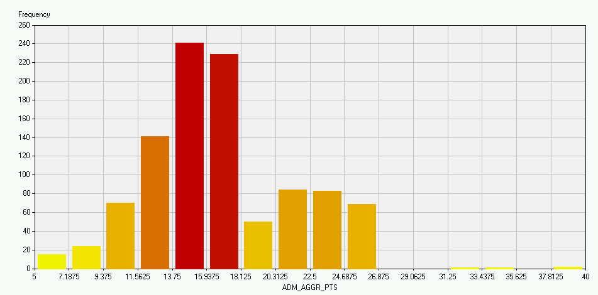
Data Understanding
Numerical Attributes

Slide 55
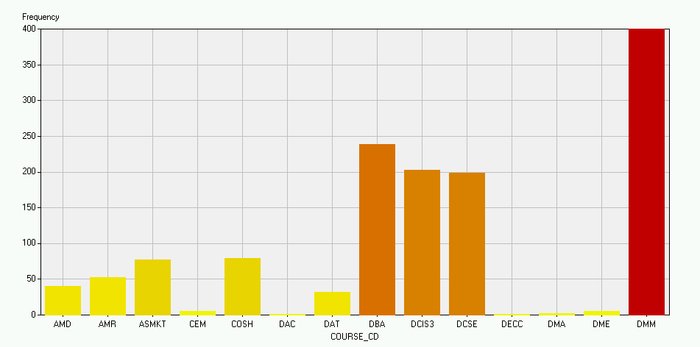
Data Understanding
Categorical Attributes

Slide 56
Data Quality
Inconsistencies must be identified & removed
Stud No. | Course code | Course name | No_net | Date-joined | Tel No.
S98001 | IT | Information Tech. | 1 | 01-Jul-1998 | 4545451
S98002 | BIT | Best Info. Tech . | 12 | 01-Jul-1998 | 5677892
S98008 | MM | Mass Media | 18 | 01-Jul-1998 | 7898003
S98010 | 1998 | Mass Me | 3 | 01-Jul-1998 | 4567890
S99123 | BIT | Business Info. Tech. | 7 | 01-Jul-1999 | 4324325
S99123 | BIT | Business Info. Tech. | 7 | 01-Jul-1999 | 4324325
S99123 | BIT | Business Info. Tech. | 7 | 01-Jul-1999 | 4324325

Slide 57
Step 3: Data Preparation - A Critical DM Task

Slide 58
Step 4: Data Modelling
Select a Modelling Technique
Modelling techniques
Modelling assumptions
Generate Test Design
Test design
Build Model
Parameter settings
Models
Model description
Assess Model
Model assessments
Revised parameter settings

Slide 59
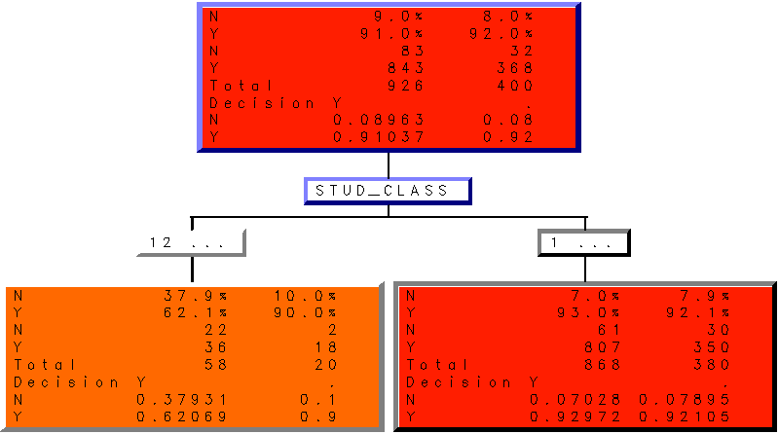
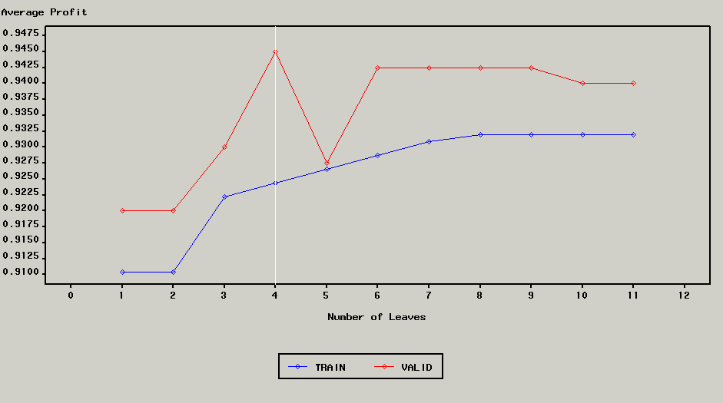
Data Modelling
Decision Tree

Slide 60
Step 5: Evaluation
Evaluate Results
Assessment of data mining results with respect to business success criteria
Approved Models
Review Process
Review of process
Determine Next Steps
List of possible actions
Make decision

Slide 61
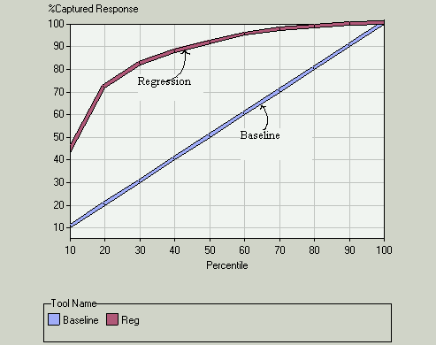
Evaluation
Percentage of captured response of the model using regression technique
X-axis indicates the percentile of the population
Y-axis indicates the percentage of captured response

Slide 62
Step 6: Deployment
Plan Deployment
Deployment plan
Plan Monitoring and Maintenance
Monitoring and maintenance plan
Produce Final Report
Final report and presentation
Review Project
Documentation

Slide 63
Summary of tasks, deliveries and activities of CRISP-DM
Six phases in the CRISP-DM process
Business Understanding
Data Understanding
Data Preparation
Modelling
Evaluation
Deployment

Slide 64
Review Questions
(A) True/False
SEMMA stands for sample, explore, modify, model and assess.
For CRISP, the phases are business understanding, data preparation, modelling, evaluation and deployment.
For CRISP, the integration of external and internal sources of data is done during the data understanding phase.
(B) Short Questions
Identify one difference between SEMMA and CRISP-DM methodology
CRISP-DM has 6 phases. Identify the key phases.

